Slide 1
By: Marwan Abdelhamid:2206174 aly waleed:22010443 Mohamed nader:22011951 peter hany:2306135 ahmed hamed:22011938 philopater awad:2206202 Mahmoud Muhammed:2206213
SMART GARAGE
& CAR PROJECT

Slide 2
Content:
1.Theoretical base
2.Components
3.Frameworks
4.Platforms
5.Circuits
6.Logic
7.Simulation
8.CAR
9.Flutter mobile/web application
10.Cyber security bonus
11.output

Slide 3

Smart garage theory :
Smart garages uses device like sensors and motors to control your garage from either your phone or automatically using various devices that overall make quality of life better. Which means monitoring and and managing your garage is easier.
THEORY: When you drive up your driveway in your car you presence is detected via IR sensor which turns on the GC which allows you to swipe your card and also lights up the LEDS that are installed on light poles. After verifying that the card you swiped is the right one the servo motors that are installed on the garage door open the door and the speaker also works which works by converting electrical signals into acoustic waves which acts as a pre recorded message, The IR also sends a message to the owner via flutter notifying him of the arrival.

Slide 4
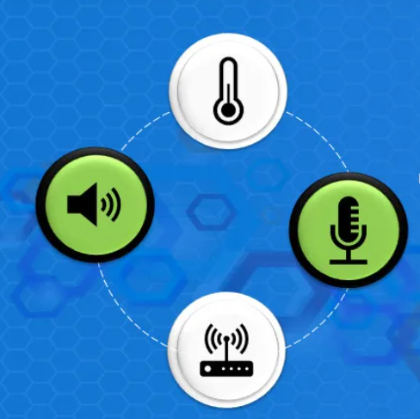
After entering the garage the door waits a delay of 5 seconds then close behind you then you are met by a PIR sensor which picks up your presence and opens the LEDS installed on the side of the walls of the garage. While getting in the garage u wont need to worry about hitting anything because of an ultrasonic sensor installed on the car which acts just like a parking sensor that is connected to a buzzer which works everytime u get near an object. Inside the garage is also installed a gas sensor which alarms a buzzer and sends a message to the owner. We also installed a temperature or humidity sensor that would alarm you incase of a fire

Slide 5

Out side the garage you would have 2 sensors installed for opening/closing the parking shade.
1.Raindrop sensor which senses when it starts to rain and automatically sends a signal to the servo motor to start opening the parking shade.
2.LDR Sensor which is a light sensor that measure the intensity of light that is transmitted to it so it could read when it’s day which would let the servo motor know to open the sun shade versus when the intensity of light changes which then lets in close again.

Slide 6
2.Components
Car components:
Garage components:
1.Dcmotor(4) and wheels
2.Motor driver(l298N)
3.LEDS(4)
4.Buzzer
5.Breadboard
6.ESP 32
7.batteries(6)
8.Car body
9.Switch
1.Sensors(Gas,Raindrop,LDR,DHT,PIR,IR,Ultrasonic).
2.LCD
3.GC522
4.Buzzer(1)
5.Push button(2)
6.Servo motor(2)
7.Speaker
8.LEDS(14)
9.Switch
11.breadboard(2)

Slide 7
Sensors:
Gas Sensor: detects the presence of different gases that may be harmful.
Purpose: when it detects gases it automatically notifies the homeowner through the flutter and giving notification the buzzer to work
Raindrop: A device that is activated by the presence of rainfall.
Purpose: Automatically opens the parking shades when It detects rainfall to protect the car and items in garage, Closes when the rain stops.

Slide 8
Light Sensor (LDR): Detect and respond to light levels.
Purpose: Detecting the difference in day and night by light level, Opening shade when it detects levels of light that indicate that it’s day to protect car from sun, closing shade when it’s nighttime by detecting change in light level.
DHT-11 Digital Temperature And Humidity Sensor (DHT): A digital temperature and humidity sensor that works by using a thermistor to measure the air.
Purpose: When it detects high temperature readings like a fire it sends a message to the homeowner using the flutter to alert him of the danger.

Slide 9
Passive infrared sensor (PIR): electronic sensor that measures infrared light radiating from objects
Purpose: When it detects presence inside the garage it opens an LED for a short period of time before switching off.
Infrared Sensor(IR): It has a transmitter that is always emitting light and waits for the emitted light to be reflected which means that there Is presence detected.
Purpose: It is placed outside of the garage and when it detects the presence of an object it opens the LED and lights the place.
Ultra Sonic Sensor: IT measures how far away an object is by sending out ultrasonic sound waves.
Purpose: We install it on the car to make it detect if the car is gonna crash into another object or car. When it detects an object is too close or or gonna crash it turns on a buzzer that warns the driver of the danger.

Slide 10
2.LCD: Installed inside the garage to display if any sensor is down or disabled.
3.GC522: Installed a GC522 that allows the user to enter the garage after swiping the right card on the pad.
4.Pushbutton: 2 buttons Installed inside the garage one for the garage door and one for the parking shader, when you press once on each it either opens or closes the responding action.
5.motors:
1)Servo motor: We use them for opening/closing the garage door or shader.
2)DC motor: It’s the motor that is used for the car to power the wheels.
3)L298N motordriver: works as a transformer to allow the dc motor to work. The ESP only outputs a certain value of volt which could be less than what the Dc motor needs to power the wheels so the l298n driver takes less voltage from the ESP and outputs more towards the DC motor

Slide 11
6.Speaker: Installed with the GC522 and when the owner inputs swipes the card to enter their home the speaker works which convert electrical signals into acoustic waves which acts as a message
7.Switch: used to switch on/off the whole project, and we installed one on the car.
8.Batteries:
(1.5v): 4 batteries powering the esp on the car which lights the leds on the car and the buzzer.
(3.7v): 2 batteries that power L298N motor driver that powers the wheels.

Slide 12
3.Frameworks:
Flutter: We used flutter to create our web site and application to control the sensors and devices that were used. We used flutter because of its crossplatform development that allowed to us run the single code on multiple platforms. We installed APK code on the web to open flutter mobile application which runs on IOS.

Slide 13
4.platforms
Wokwi: Wokwi is a web-based tool or platform that simulates electronic sensors and projects. We used it to simulate or the sensors and motors working together in a small schema showing how they would work in a simulation.
Hive-MQ: Hive-mq is an MQTT broker which acts as a server between clients that receives messages and distributes them to the directed client. It ensures reliability even for large scale iot projects. It’s responsible for publishing/subscribing messages which is This is important for IoT applications where data integrity is needed. We used it for the flutter which we already subscribed and published with the same esp.

Slide 14
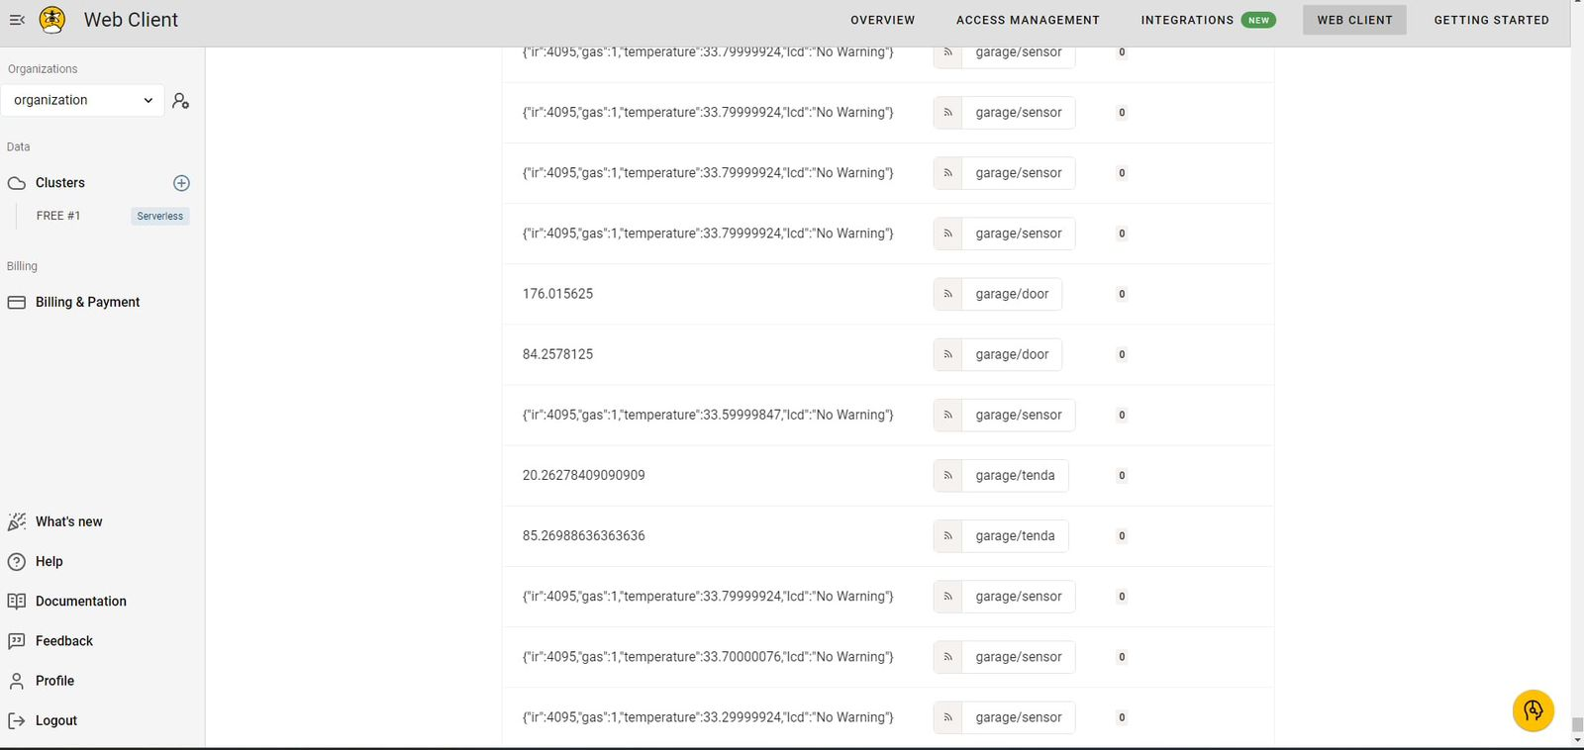
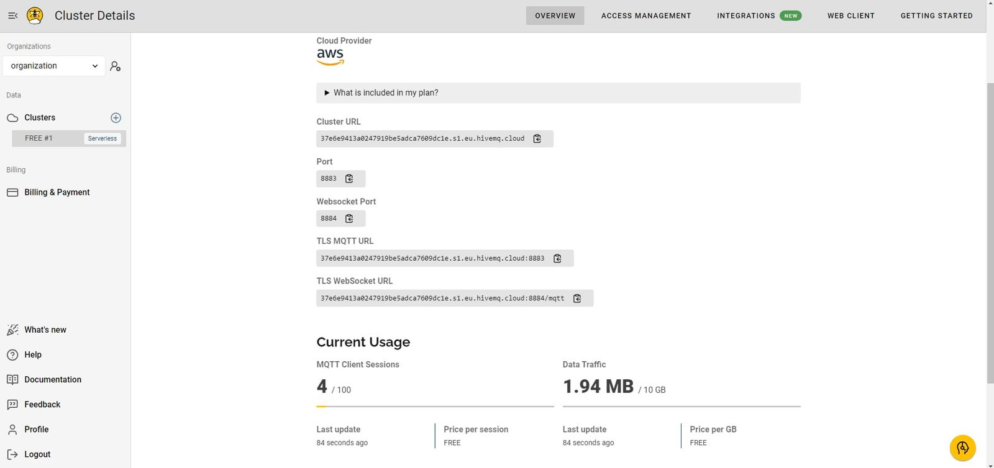
Hive-mq readings

Slide 15
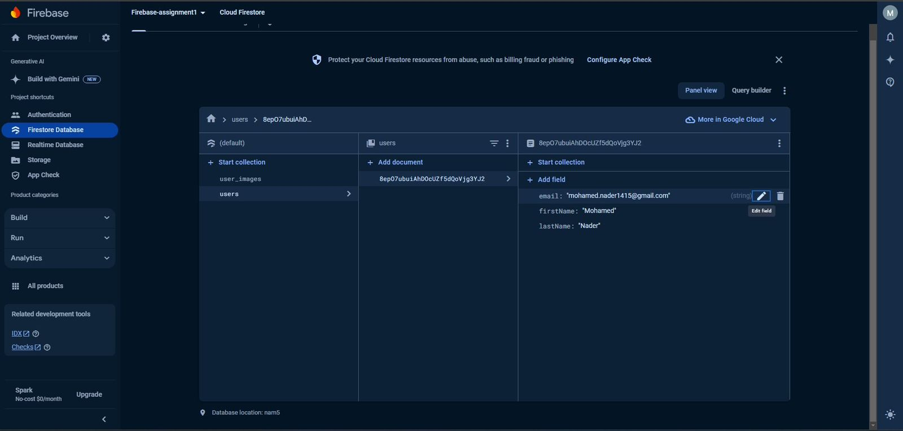
User login and authentication via web or mobile application.
Firebase: Firebase Realtime Database is a NoSQL cloud database that allows you to store and sync data between your users. Which is useful for apps with real time updates. We use Firestore which is a feature within Firebase which is a cloud database which is more scalable than real time databases that helps us store user details.
We also use Fire base authentication which provide various easy to use authentication services like email/password, phone authentication, and federated identity providers which are big sites that need to keep their user data hidden.
We also used IOS for flutter and used esp 32 for our hardware.

Slide 16
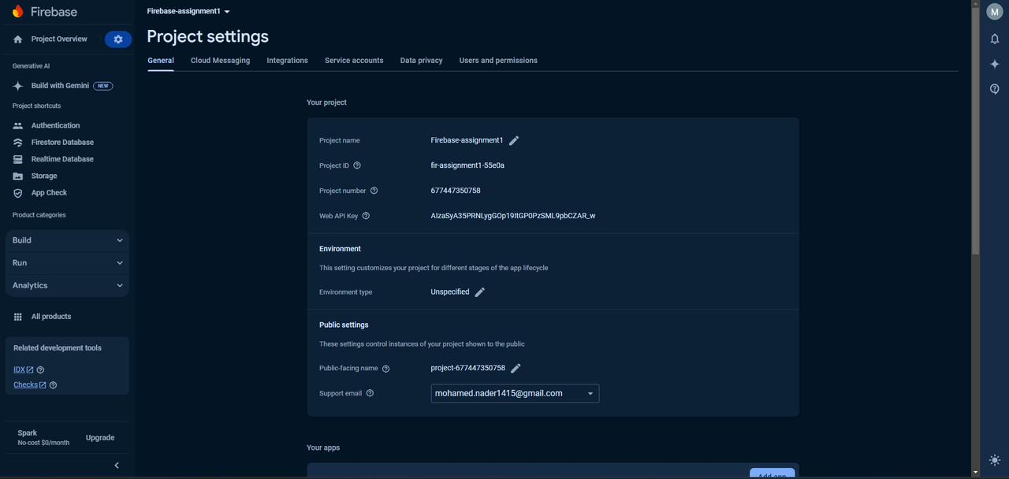
Fire base profile settings

Slide 17
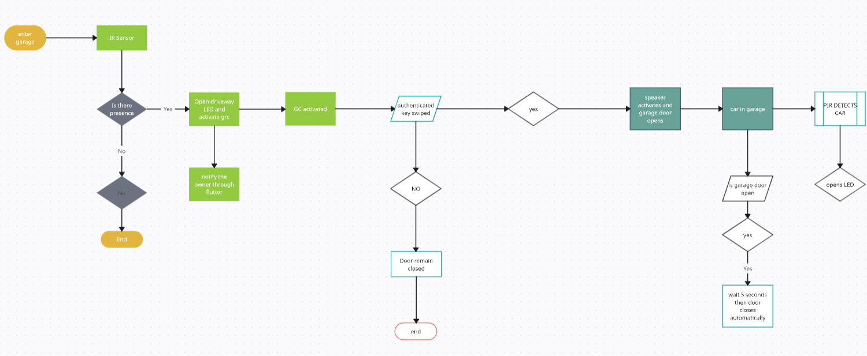
5.Circuits:
1.Entering the garage

Slide 18
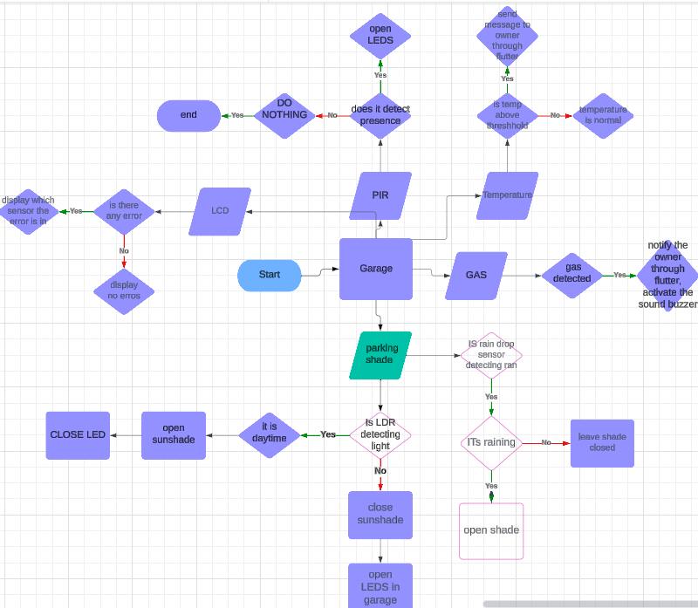
2.Inside the garage

Slide 19
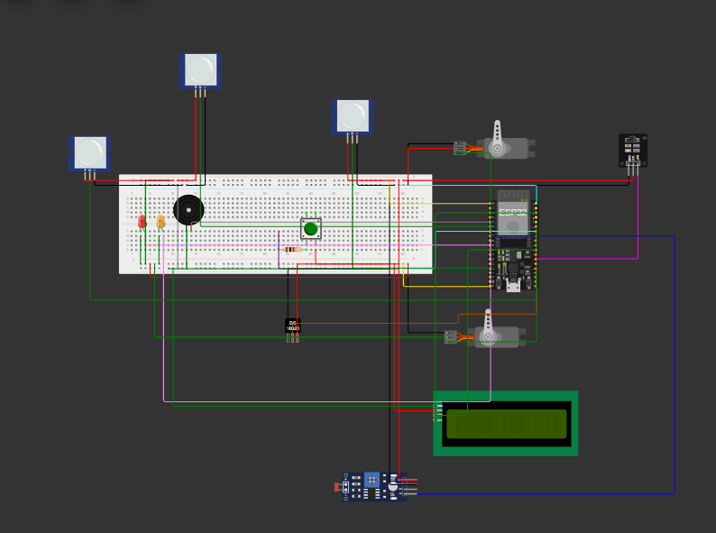
7.simulation
RAINDROP Sensor
PIR Sensor
1.Sensors, motors
GAS Sensor

Slide 20
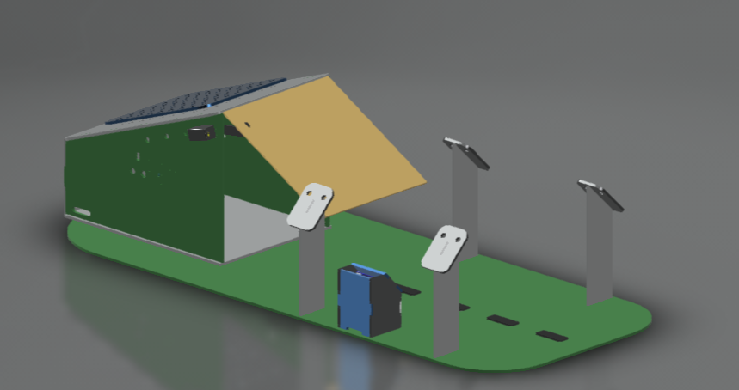
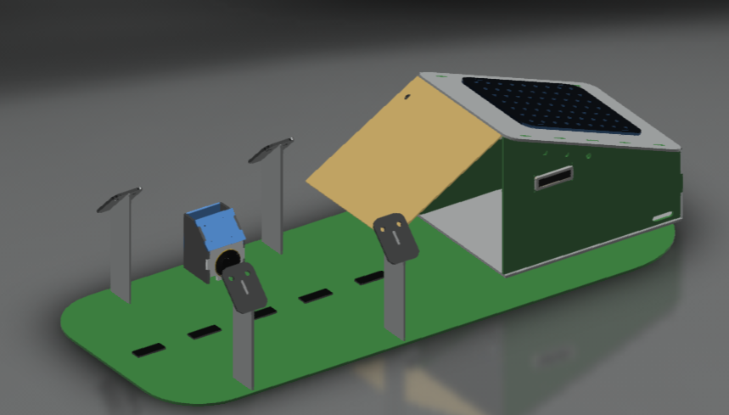
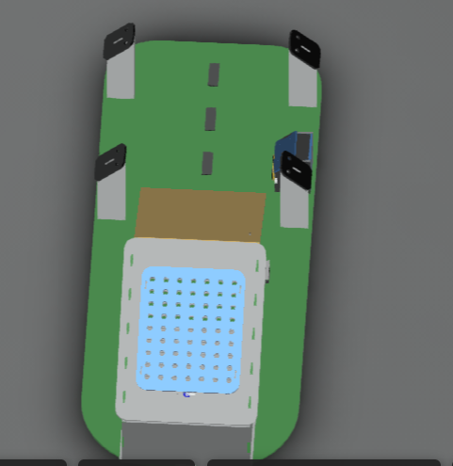
2.Garage 3D model By Fusion.

Slide 21
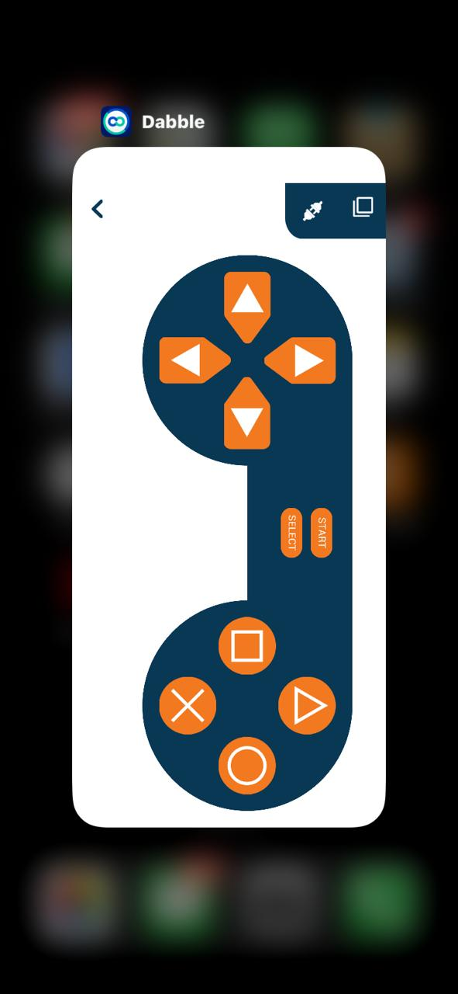
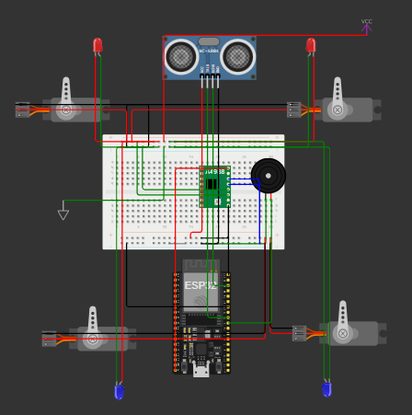
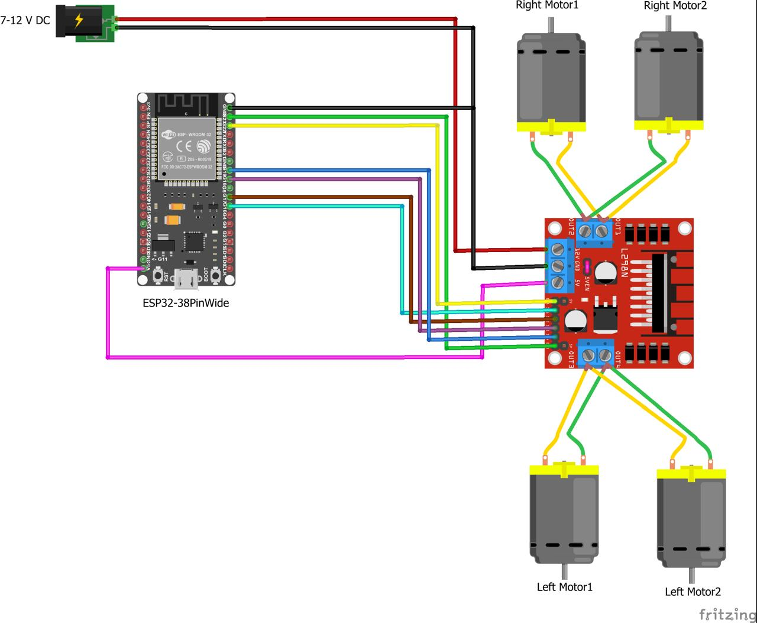
3.CAR
OBLAK: app that helps us control the car
Simulation with motor drive
With servo motors acting as a dc motor

Slide 22
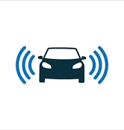
8.Car theory
We also made a car that would simulate an actual car going inside the garage. We built the car using an ESP32,breadboard,dc motor,l298N motor.
The car is powered by 4 1.5v batteries that power the ESP that gives power to the lEDS placed infront of the car that act as lights
And buzzer which is connected to the ultrasonic sensor which acts as a distance sensor that helps you from hitting other objects.it detects if your getting too close to an object then sends signal to the buzzer to work to notify you of the danger. We also have a L298N motor that is powered by 2 3.7 volt batteries that give power to the DC motor to power the wheels to go in any direction. We also installed LEDS on the side of the car to act as car turning signals which are controlled by the OBLAK app to light when pressing left or right.

Slide 23

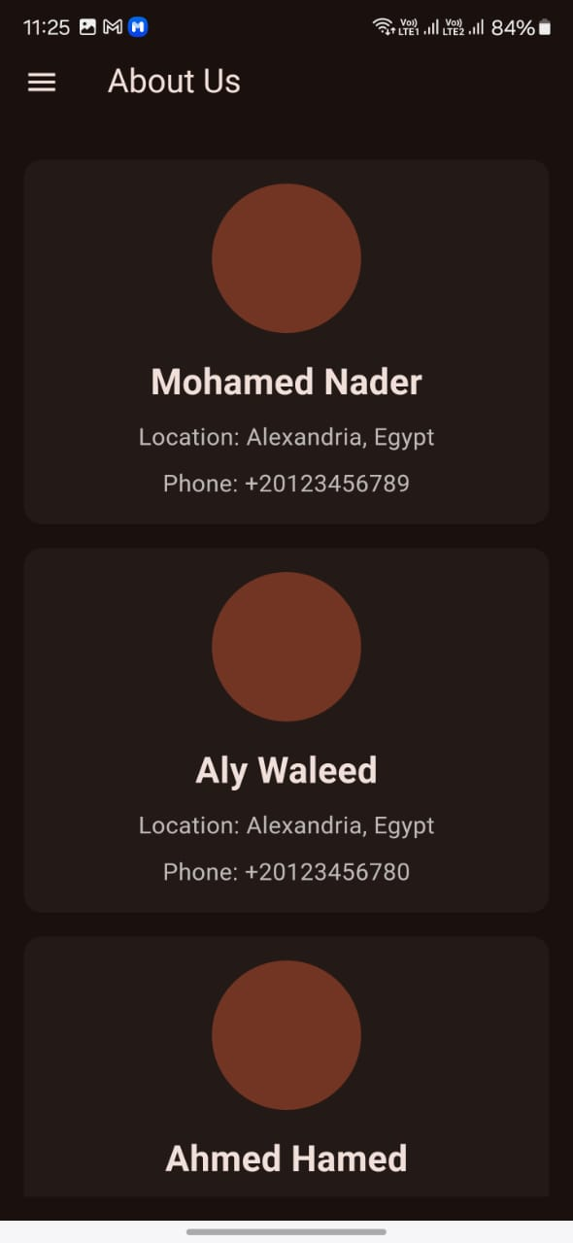
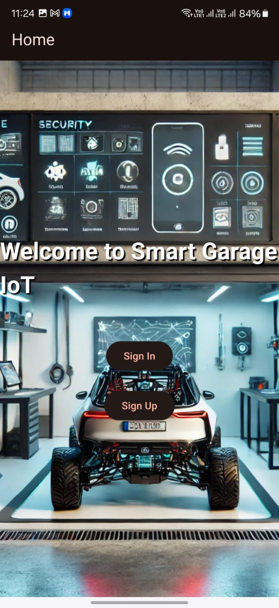
Flutter mobile application
About us
profile
Home page

Slide 24
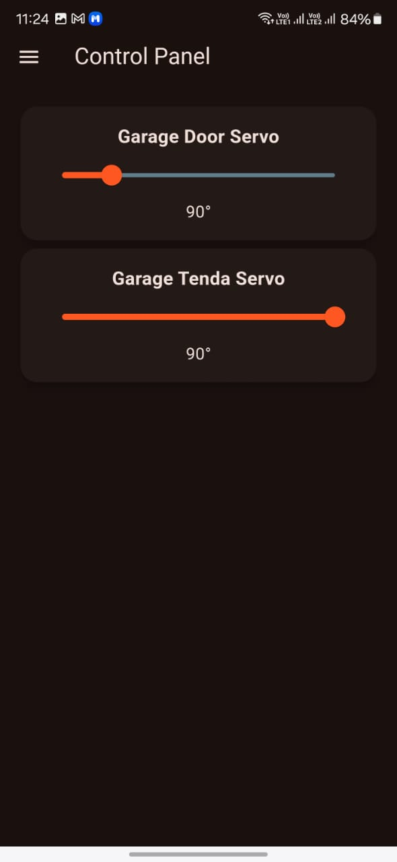
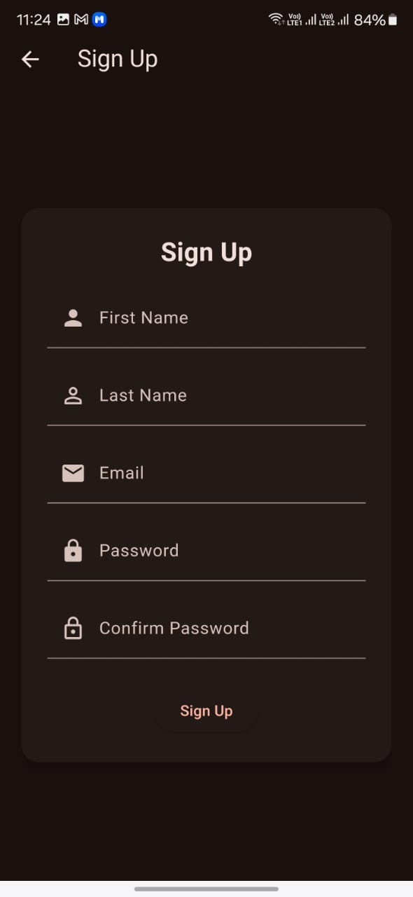
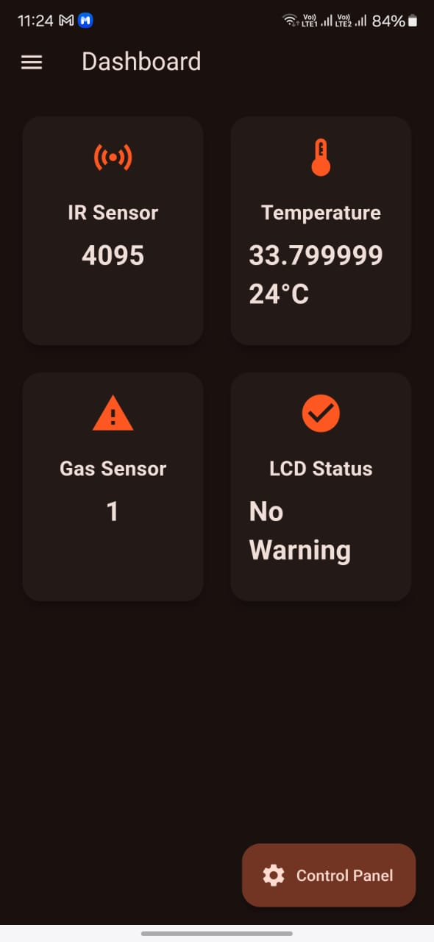
Control panel
Sign up page
Dashboard

Slide 25
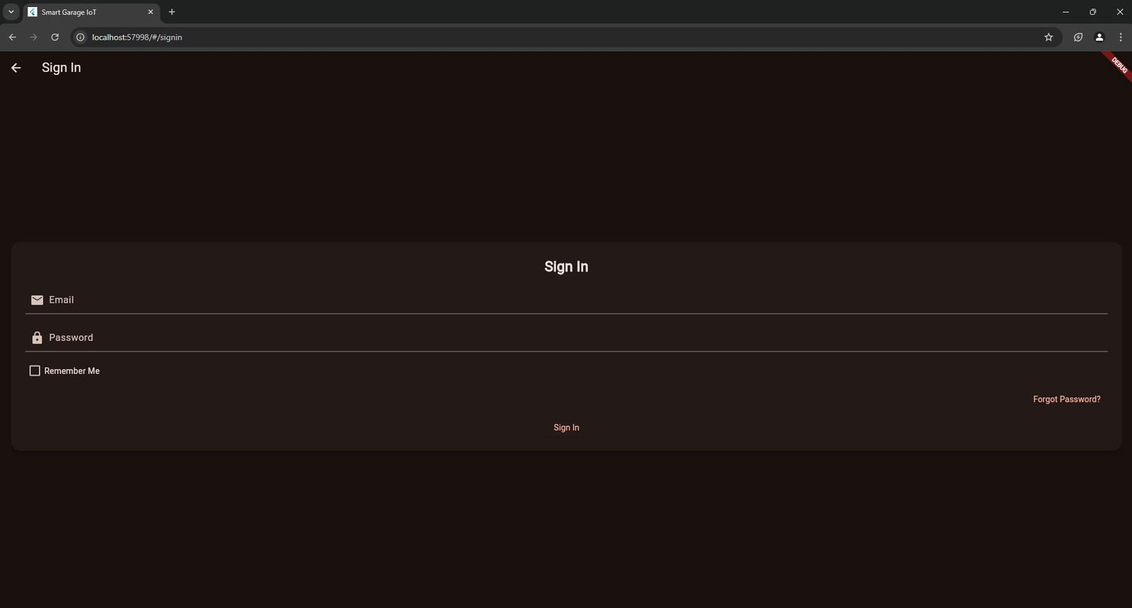
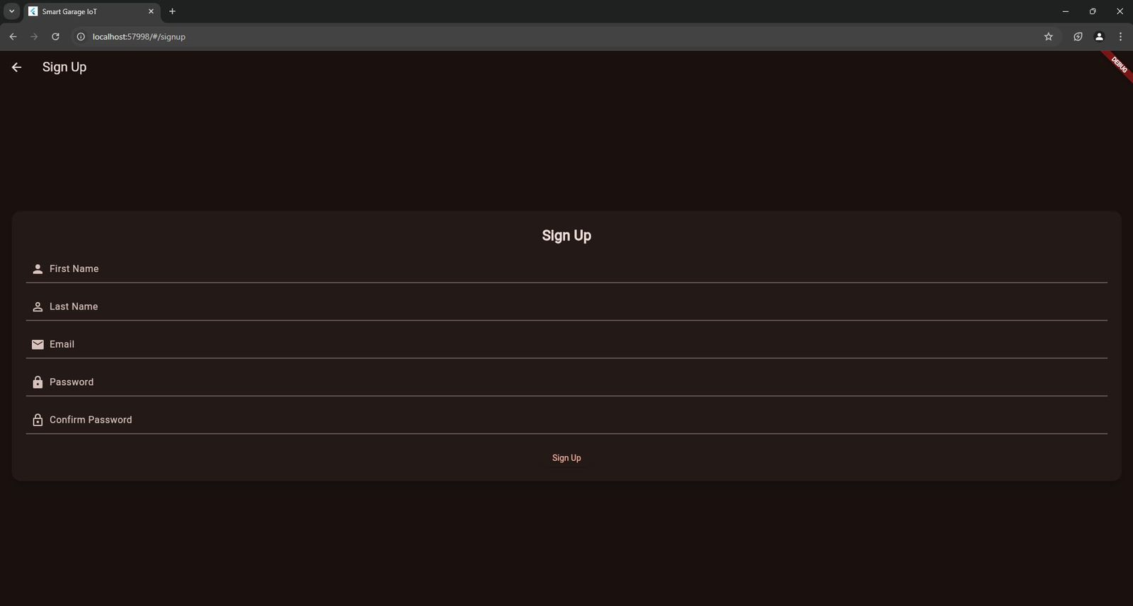
Flutter web application
Sign in page
Sign up page

Slide 26
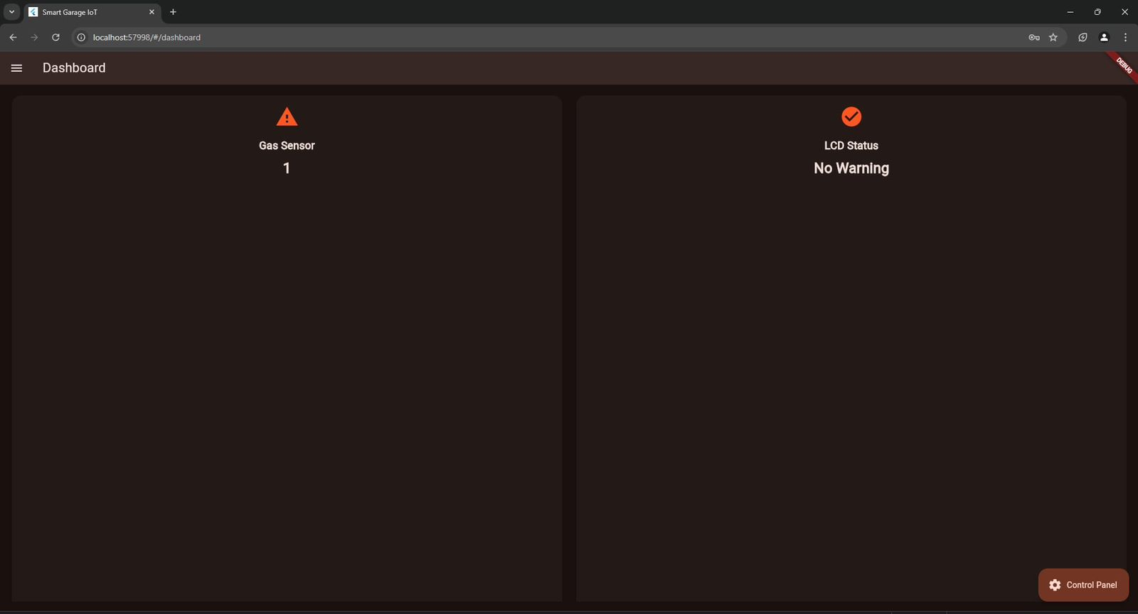
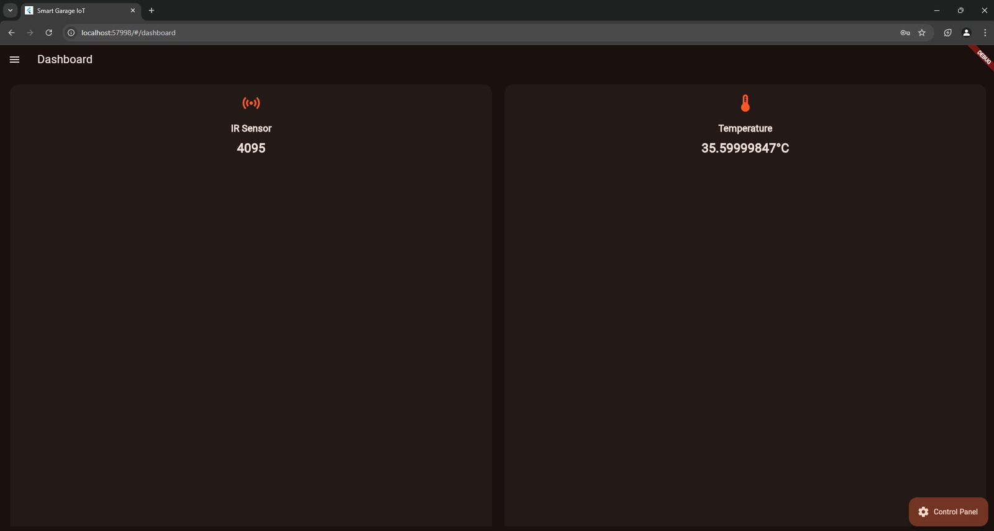
Dashboard

Slide 27

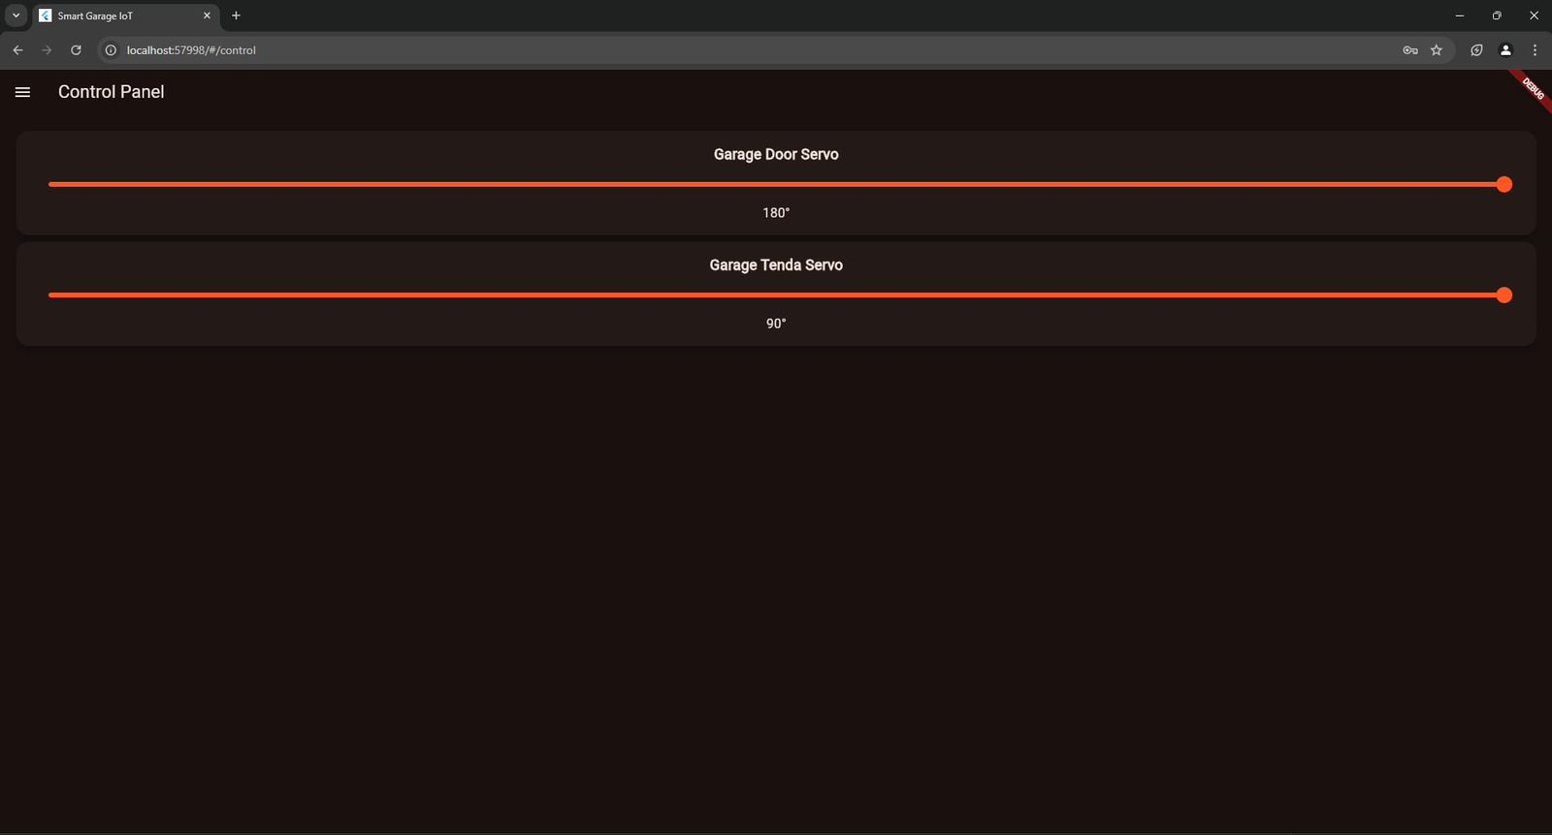
About us
Control panel

Slide 28
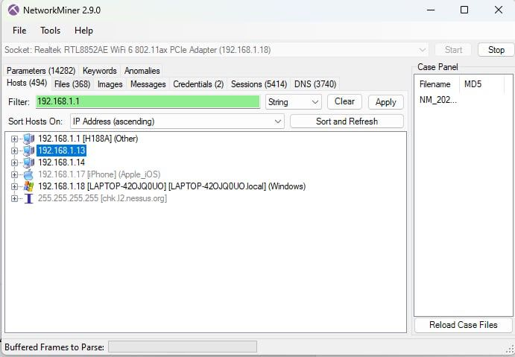
Cyber security bonus
1.Network Miner
We used a feature in the network miner that can analyze and capture network traffic which we used to get the ip of the ESP by installing the network miner tool on the same machine that is connected to esp which it detected by wifi.

Slide 29
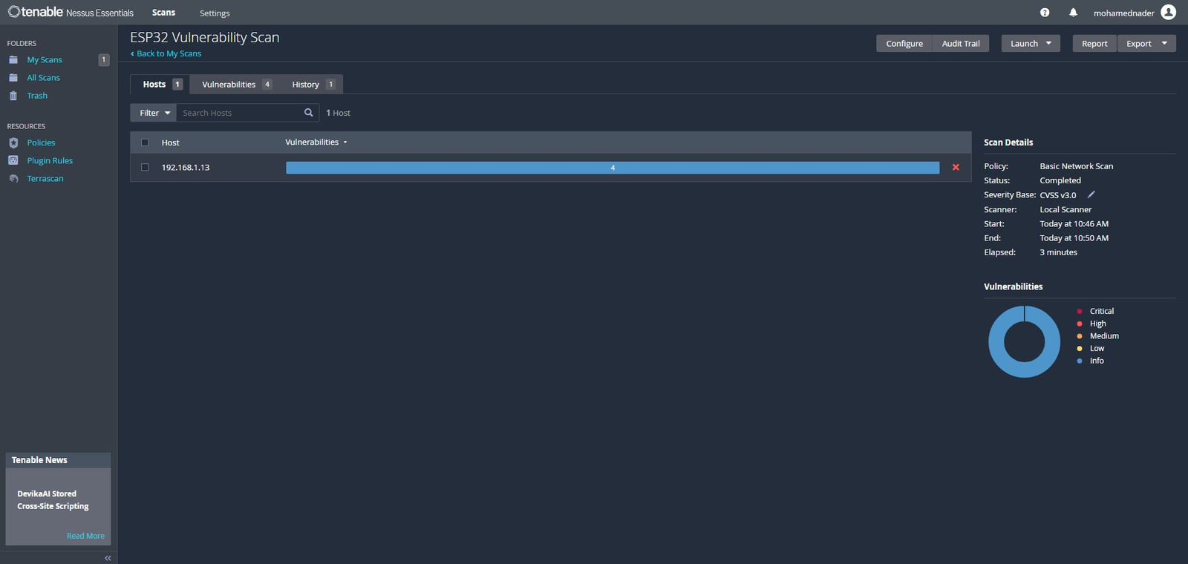
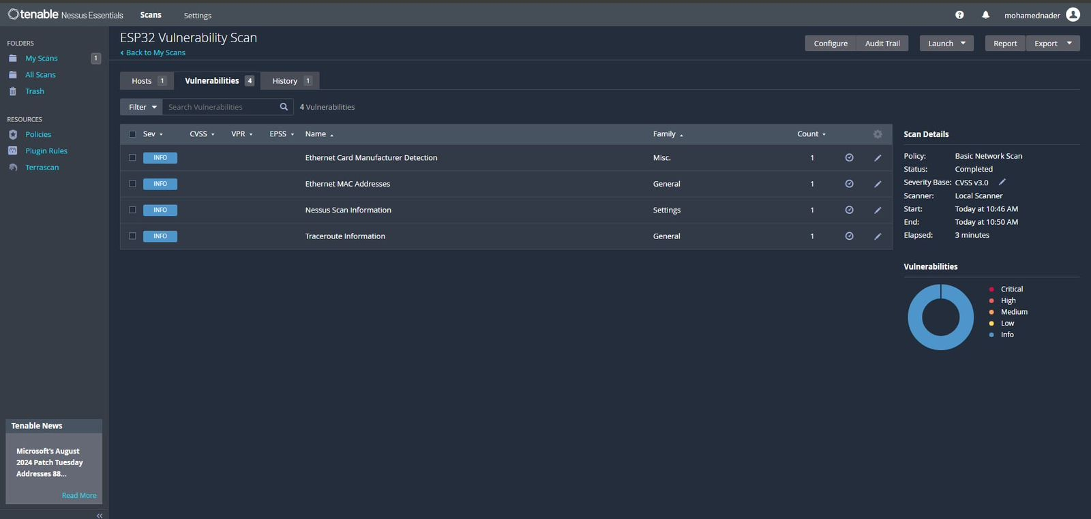
2.Nessus
Nessus is a vulnerability assessment tool design to scan a network and identify all security threats or leaks
Testing the ESP for vulnerabilities
These were the vulnerabilities we found within the network

Slide 30
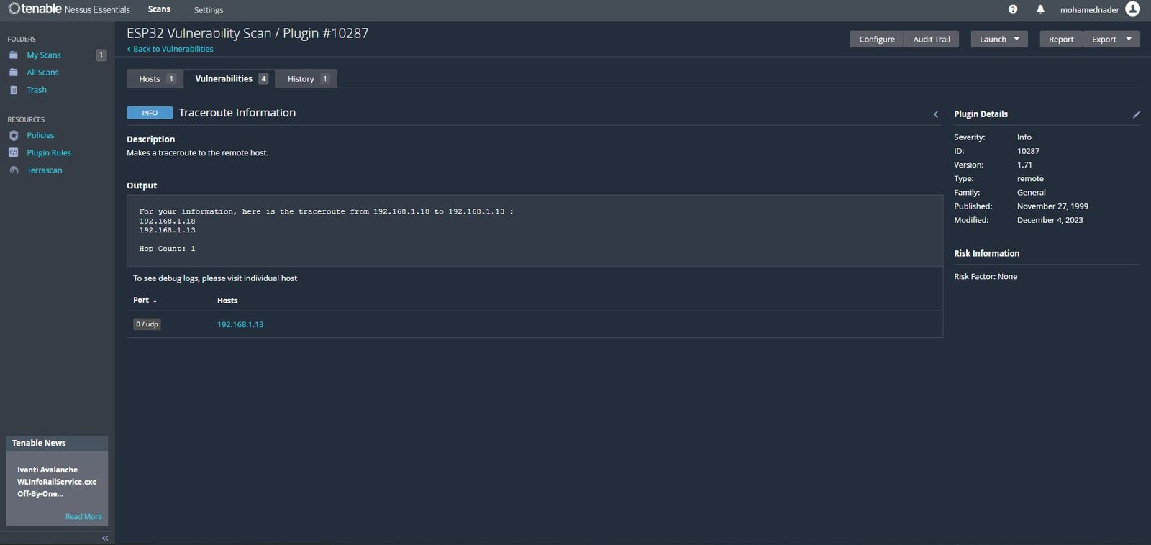
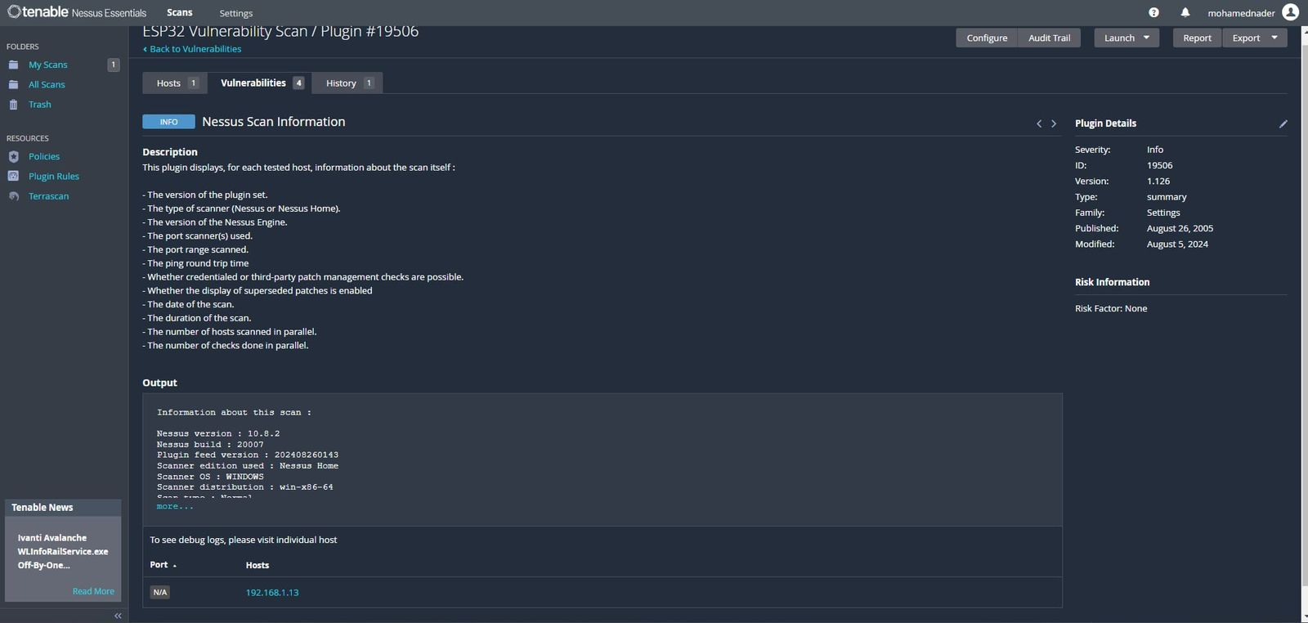
Vulnerabilities
Traceroute information
Nessus scan information
When the user sends a request to server the request is traced back to its owner so their ip is leaked
exposure of metadata and details about the Nessus scan itself that can be retrieved by an attacker or unauthorized user

Slide 31
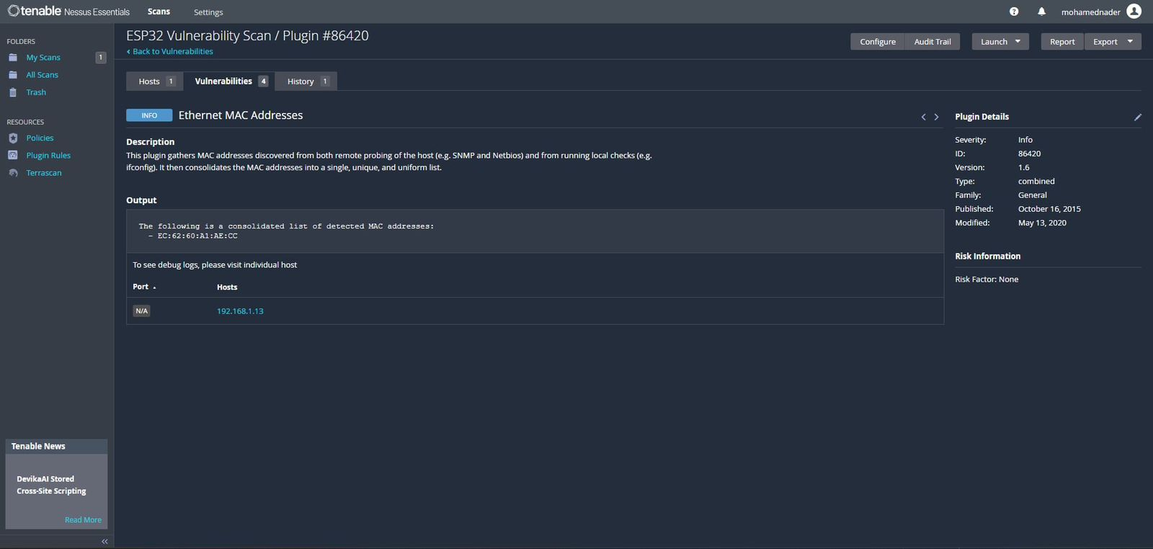
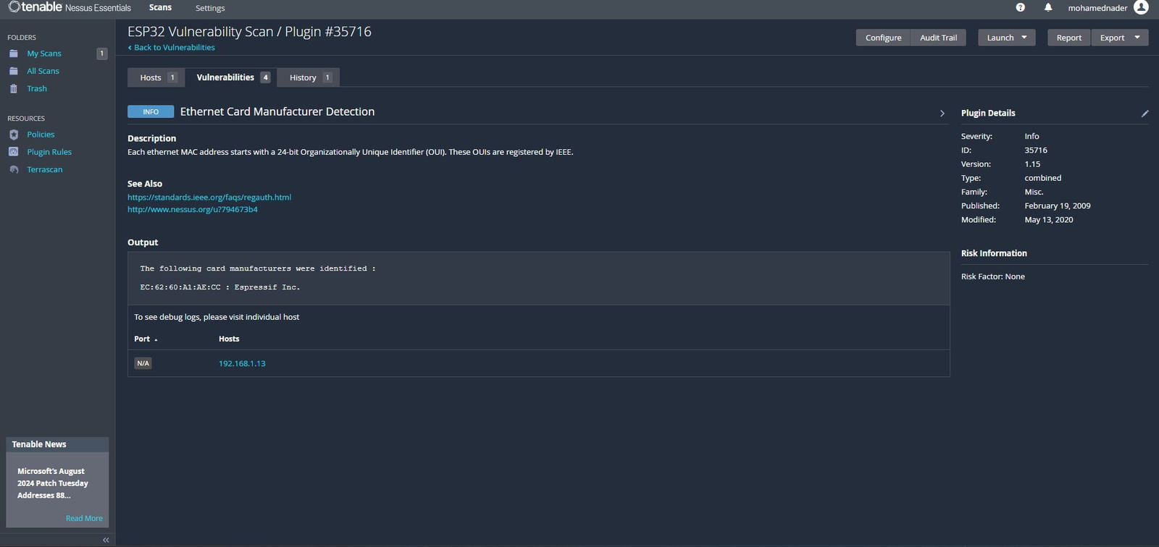
Ethernet MAC address
Ethernet card manufacturer detected
The risk is that attackers can use or fake a device's MAC address to get into a network without permission.
knowing the manufacturer of an Ethernet card can give attackers useful information about the device like its model and any known vulnerabilities.

Slide 32
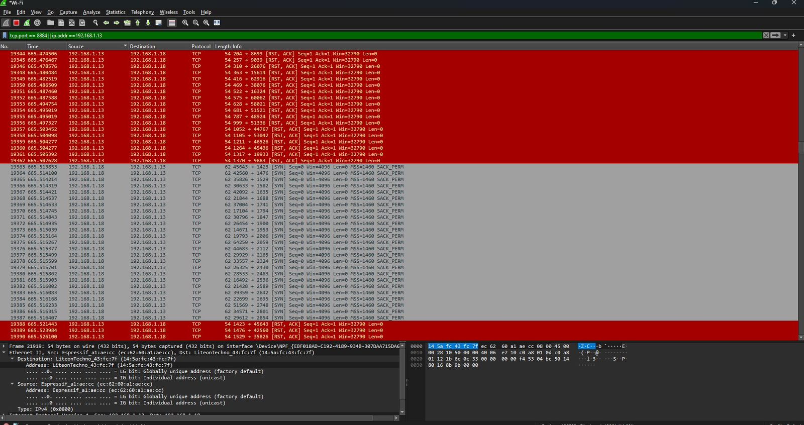
3.Sniffing the ESP32 real time readings sent the real time firebase database using wire shark
Sniffing the packets that are sent from the ESP by hivemq to the firebase using wireshark.
Data is encrypted and can only be decrypted by someone who has the private key of the tls algorithm
TLS algorithm: is a protocol used to secure communications over a network. It provides encryption, authentication, and integrity for data transmitted between clients and servers

Slide 33
12.output
We made a visual representation of how this project would work in details in thid drive link:
https://drive.google.com/drive/folders/12x1aUslR-4TITJ-8wbWcSDlw2TCF2kGu
this link have the 3D model design with fusion:
https://a360.co/3WXQ4cY

Slide 34
THANK YOU

